Slide 1
Improved city maintenance via machine learning
Christian Cleber Masdeval Braz

Slide 2
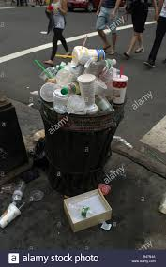
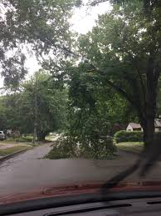

Introduction
City maintenance is challenging and expensive.

Slide 3
Problem
Two main problems:
Where are the issues
What to solve first

Slide 4




Assistance via crowdsourcing
Solving the first part can be assisted by

Slide 5
Common features
Reporting an issue:
Brief description
Long description
Source
Location
Tracking an issue:
Number of votes (proxy for urgency)

Slide 6
Assistance via ML
Crowdsourcing platform alone is not enough.
Make it more effective by allowing immediate ranking of the issues.
As a result, governments can be more efficient, responsive and better fulfil citizens needs.

Slide 7
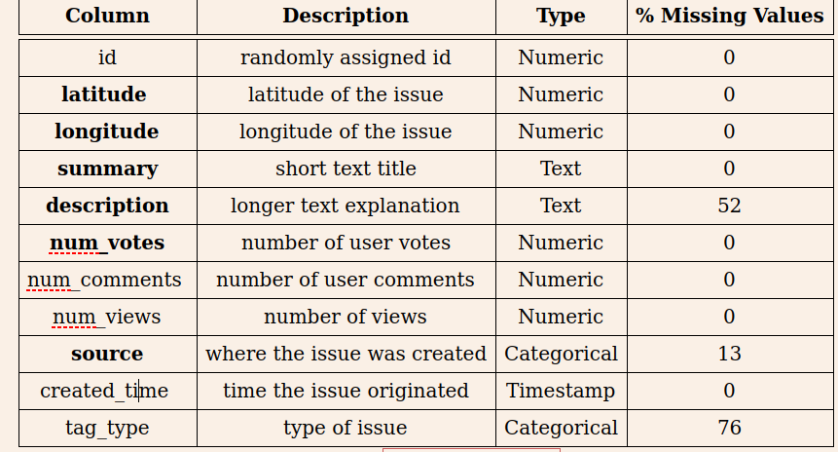
The Dataset

Slide 8
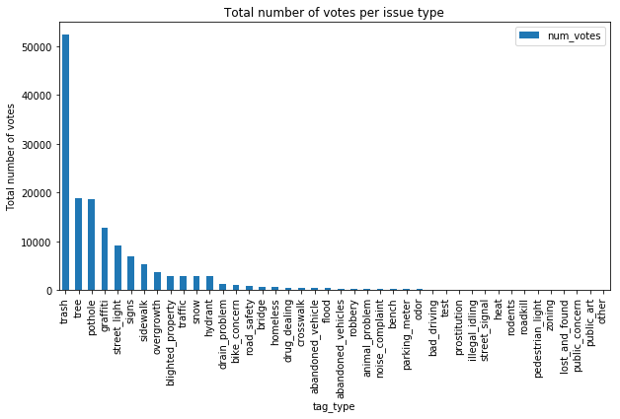
The Dataset

Slide 9
The Experiment
Models
Lasso
Ridge
SVM
Bi-LSTM
Part A: model fitting using only the textual features.
Part B: model fitting using all features.

Slide 10
The Experiment
Preprocessing
Prediction and Summary: binary BOW representation with 5000 words vocabulary size and pruning words that occur in more than 50% of the documents. To use with LSTM we convert each word in a 200 dimensional word embedding.
Source: convert to its one-hot-encoding representation.
Location: as they are latitude and longitude values represented as decimal degrees, scale and round to three decimal places which corresponds to neighborhood precision.

Slide 11
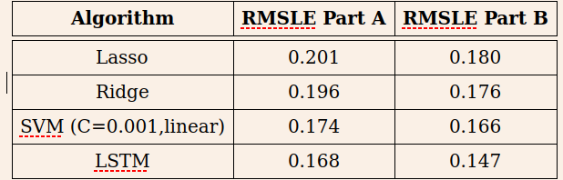
The Experiment

Slide 12
Conclusion

